Slide 1

SRI KRISHNARAJENDRA SILVER JUBILEE TECHNOLOGICAL INSTITUTE
Department Of Computer Science And Engineering
PROJECT PRESENTATION ON PHASE 2
“AUTOMATED CRIMINAL IDENTIFICATION BY FACE RECOGNITION”
SUBMITTED BY,
D SUPRITH (1SK19CS010) MADHU SUDHAN N (1SK19CS022)
MITHUN KUMAR G T (1SK19CS023)
SUDHAKAR (1SK20CS413)
Under the Guidance of Prof. Somesha M
Assistant Professor
Dept. of CSE

Slide 2
Contents
Introduction
Problem Statement
Existing System
Proposed Statement
Literature Survey
System Analysis
Objectives
Methodology
System Design
Implementation
Result
Conclusion and Future Scope
References

Slide 3
INTRODUCTION
Criminal identification is the most important task for the Police who are finding the criminals, but it is the difficult and most time-consuming task as they have to find it everywhere.
It will be more difficult in cities or public places with high people density. In some cases, manual type of identification gives chance for getting more information related to criminals.
Hence an automatic criminal identification system by detecting the face of criminals. This will help Police to identify and catch the criminals in public places.

Slide 4
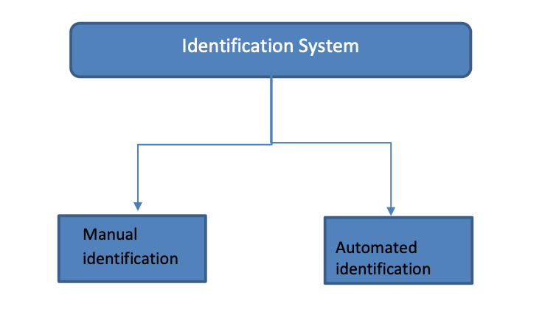
Criminal identification can be done in two ways,
Manual Identification System (MIS): Identification is done by the Police officers searching them at public places. It takes a lot of time to give the proper attention.
Automated Identification System (AIS): There is no need for observation going in a public place. Here all the process involved in this system is automated.

Slide 5
PROBLEM STATEMENT
To develop an application which will serve a way to register and track criminals remotely with the help of criminal data.

Slide 6
EXISTING SYSTEM
As the crime rate and criminals are increasing day by day managing, finding and tracking these criminals is a major issue for police personnel.
There are application which will help police department to store the records and data about a criminal but these applications won’t help in finding those criminals.
Criminal details were mainly managed using records books or stored as software records in the database.
Previously when a criminal is found guilty the picture of the criminal is being taken and stored in records but these pictures serve no purpose.
The existing methods will only help in managing criminal records and those methods will not finding criminals from any location.

Slide 7
DISADVANTAGES OF EXISTING SYSTEM
It doesn’t efficient for large volume of data’s.
Training time is more.
The process is implemented without removing the noise.
Prediction is not accurate.

Slide 8
PROPOSED SYSTEM
The proposed system is developing an application called Real-Time criminal identification system based on face recognition.
We use Haar feature based cascade classifiers in OpenCV approach for face detection. It is a machine learning based approach where a cascade function is trained from a lot of positive and negative images. It is then used to detect objects in other images.
We use Local Binary Patterns Histograms (LBPH) for face recognition. This application helps police personnel in many ways.
We can register a criminal, once it is successfully done we can track and find criminals using CCTV footage or by manually giving image as input. Data of criminal is managed through dataset. When a criminal is detected at any time on camera (CCTV) criminal details will be displayed.

Slide 9
LITERATURE SURVEY
SL.NO | TITLE | AUTHOR | METHODOLOGY | CONTRIBUTION | EFFICIENCY | DRAWBACKS | FUTURE SCOPE
1. | Face Recognition for Criminal Identification: An implementation of principal component analysis for face recognition | Nurul Azma Abdullah ,Et Al | The study will carried out using evolutionary prototyping methodology that consists of five phases, namely: (1) planning; (2) requirement analysis; (3) design; (4) implementation and testing; and (5) maintenance | The main function of FRCI—image identification, was programmed with detection and extraction of image, projecting image and recognition of the image. | Accuracy -around more than 70% | A lot more testing and debugging is needed as this Application | The system can feature an image processing where the input image can be made less blurry so the system can detect face on lower quality images.
2. | Automated Criminal Identification By Face Recognition Using Open Computer Vision Classifiers | Apoorva.P, Et Al | It undergoes feature extraction where Haar cascade is used methodology steps 1) planning; (2) requirement analysis; (3) design; (4) implementation and testing; and (5) | Face recognition system based on Haar cascade will be implemented. Even though the stored set of images of the person in the database differ from the input image | Accuracy -around more than 75% | Smaller images with only main features require least processing to train the Haar wavelets. | Some changes in the new face image to be recognized can be allowed.

Slide 10
SL.NO | TITLE | AUTHOR | METHODOLOGY | CONTRIBUTION | EFFICIENCY | DRAWBACKS | FUTURE SCOPE
3. | Automated Criminal Identification By Face Recognition Using Open Computer Vision Classifiers | Impana.H.C Et Al | Methodology steps 1) planning; (2) requirement analysis; (3) design; (4) implementation and testing | Face recognition system based on Haar cascade will be implemented. | Accuracy -around 80% | It used to take much time to find any criminals | some changes in the new face image to be recognized can be allowed.
4. | Real-Time Criminal Identification System Based On Face Recognition | Mr.R.Prashanth Kumar,Et Al | Various categories of facial recognition algorithms: 1. Neural networks. 2. Feature analysis. 3. Graph matching. 4. Information theory. | This project is intended to identify a person using the images previously taken. The identification will be done according the previous images of different persons. | Application is 95 percent accurate | We can not detect and recognize faces of the criminals in a video stream obtained from a camera in real time. | Improving the results. Creating Login page for police personnel. Alert message if criminal found nearby police.

Slide 11
SL.NO | TITLE | AUTHOR | METHODOLOGY | CONTRIBUTION | EFFICIENCY | DRAWBACKS | FUTURE SCOPE
5. | Automated Criminal Identification System using Face Detection and Recognition | Piyush Chhoriya, Et Al | They have used Local Binary Patterns Histograms (LBPH) for face recognition. | We can detect and recognize faces of the criminals in a video stream obtained from a camera in real time. | This application has 80% accurate. | Low Efficient selection of features, Scale and location invariant detector. | We scale the features. LBPH recognizer can recognize faces in different lighting conditions with high accuracy.
6. | Criminals And Missing Children Identification Using Face Recognition And Web Scrapping | •S Ayyappan & S Matilda | It involves four major steps. They are 1)Image Acquisition 2)Face Detection Haar Cascade Classifier method is used 3)Feature Extraction 4)Template Matching | Face recognition is a biometric based technology that maps an individual’s facial features mathematically and stores the data as a face print. | The results displayed are 90% accurate. | The main disadvantage of existing method is it is completely rely on a static dataset and requires a prolong time interval for training the face database. | The image is converted from RGB to Grayscale and HSV colours with modified XML of cascade classifiers.

Slide 12
SYSTEM ANALYSIS
FUNCTIONAL REQUIREMENTS:
MODULE 1: Capturing of Face- This will capture the real time image through web camera for first layer security i.e. face recognition.
MODULE 2: Building Training model- This module we are building LBPH algorithm to train the face images for face recognition
MODULE 3: Face Detection This will detect by face from the camera feeds.
MODULE 4: Authentication of User- In this module we are authenticating the user with face.

Slide 13
NON FUNCTIONAL REQUIREMENTS:
Non functional requirements, as the name suggests, are requirements that are not directly concerned with the specific functions delivered by the system.
Learn ability: The software is very easy to use and reduces the learning work.
Reliability: This software will work reliably for low resolution images.
Flexibility: It provides the users to provide multilayer security.

Slide 14
OBJECTIVES
To identify the person is crime or not from face image effectively. To enhance the overall performance for classification algorithms.
The main objective of Real-time criminal identification based on face recognition. Application is to help police personnel to identify criminals.
The objective of this application is to provide information about a particular criminal which we are finding.

Slide 15
METHODOLOGY
We are using CCTV Camera to capture the images of the Public so that we can identify the proper person who is having a criminal record in the database to catch.
First, we will find out the face encodings of the criminal database images
Now we are using CCTV to capture Public images placed under some public areas.
Extracting the features from captured images .
Comparing Captured image with face encodings of the criminal database images
If the encoding values matching with captured image encoding values, then criminal image, name, and criminal found message will be displayed on the screen.
Image of that person will be saved into a special folder , so that police can easily identify the criminal who differs from other peoples present in a public place.

Slide 16
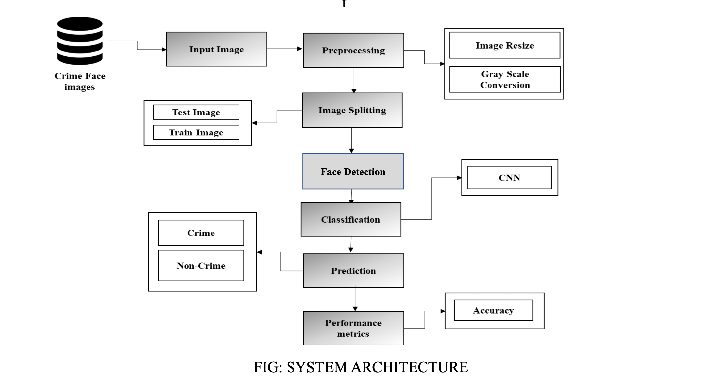
SYSTEM DESIGN
Criminal Details

Slide 17

USE CASE DIAGRAM
Register criminal Info
Images
Storing
Capture Image
Prediction
SYSTEM
USER
Display Criminal Data

Slide 18
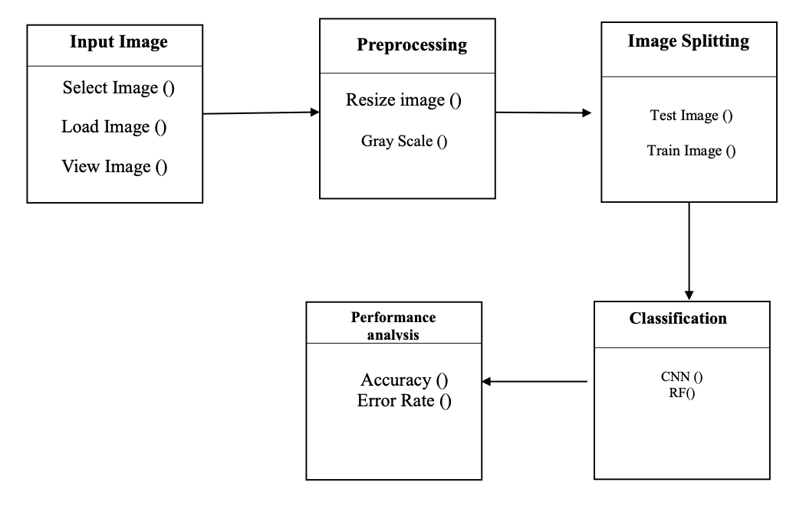
CLASS DIAGRAM
Prediction
Criminal_Info ()

Slide 19
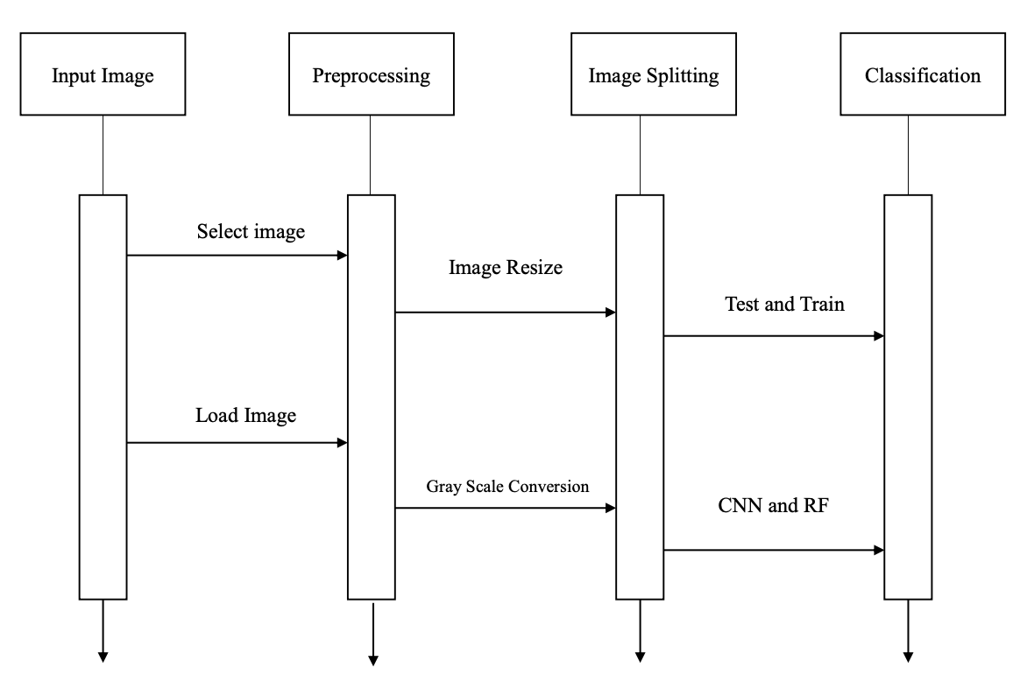
SEQUENCE DIAGRAM
Prediction

Slide 20
IMPLEMENTATION
Import the required modules
Load the face detection Cascade
Create the Face Recognizer Object
Prepare the training set and Perform the training
Testing

Slide 21
Import the required modules
The Modules required to perform the facial recognition are cv2, os, image module and numpy.
cv2 is the OpenCV module and contains the functions for face detection and recognition.
OS will be used to maneuver with image and directory names.
First, we use this module to extract the image names in the database directory and then from these names individual number is extracted, which is used as a label for the face in that image.

Slide 22
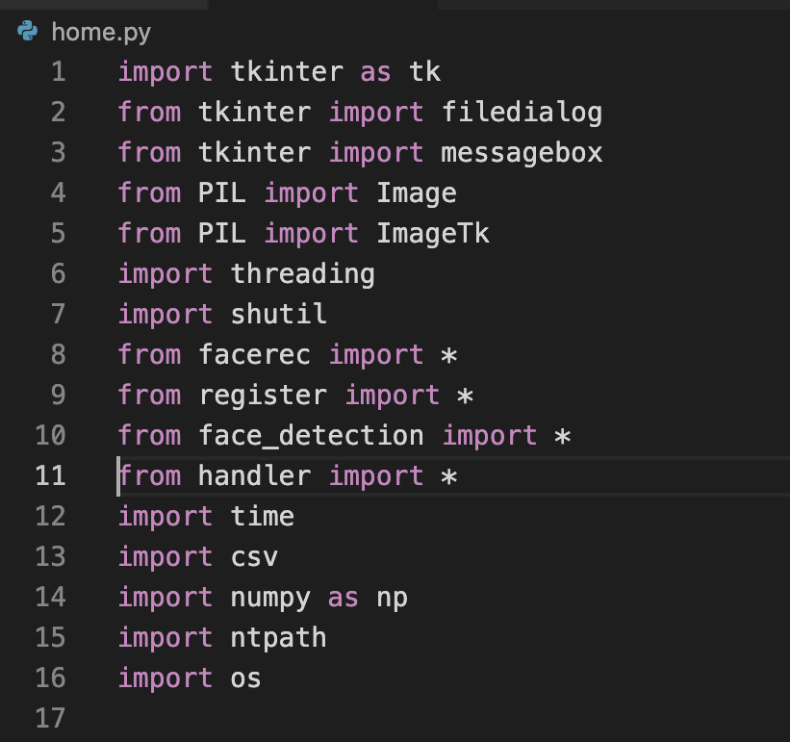


Slide 23



Slide 24
Load the face detection Cascade
To Load the face detection cascade the first step is to detect the face in each image. Once we get the region of interest containing the face in the image, we use it for training the recognizer.
For the purpose of face detection, we will use the Haar Cascade provided by OpenCV.
The haar cascades that come with OpenCV are located in the directory of OpenCV installation.

Slide 25
Create the Face Recognizer Object
The next step involves creating the face recognizer object.
The face recognizer object has functions like FaceRecognizer.
train() to train the recognizer and FaceRecognizer.
predict() to recognize a face [13].
OpenCV currently provides Local Binary Patterns Histograms(LBPH) Face Recognizer

Slide 26
Prepare the training set and Perform the training
To create the function to prepare the training set, we will define a function that takes the absolute path to the image database as input argument and returns tuple of 2 list, one containing the detected faces and the other containing the corresponding label for that face.
For example, if the ith index in the list of faces represents the 4th individual in the database, then the corresponding ith location in the list of labels has value equal to 4.

Slide 27
Testing
For testing the Face Recognizer, we check if the recognition was correct by seeing the predicted label when we bring the trained face in front of camera.
The label is extracted using the os module and the string operations from the name of the sample images folder.
Lower is the confidence score better is the prediction.

Slide 28
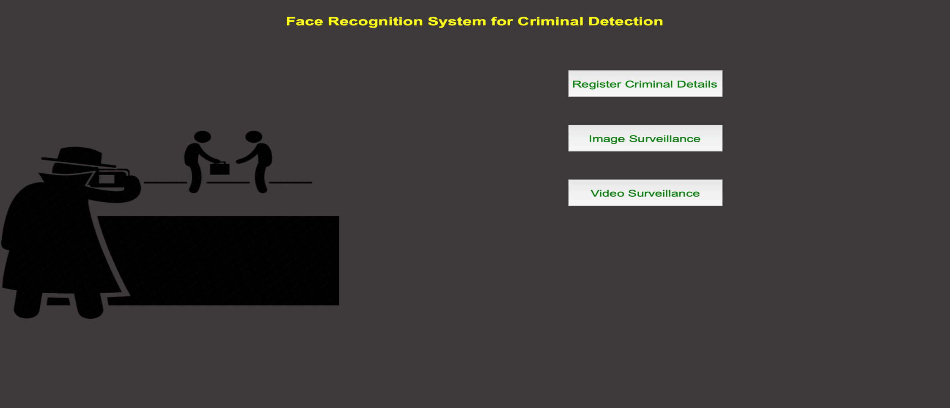
RESULTS
Homepage: Homepage contains three buttons Register Criminal, Detect Criminal and Video Surveillance.

Slide 29
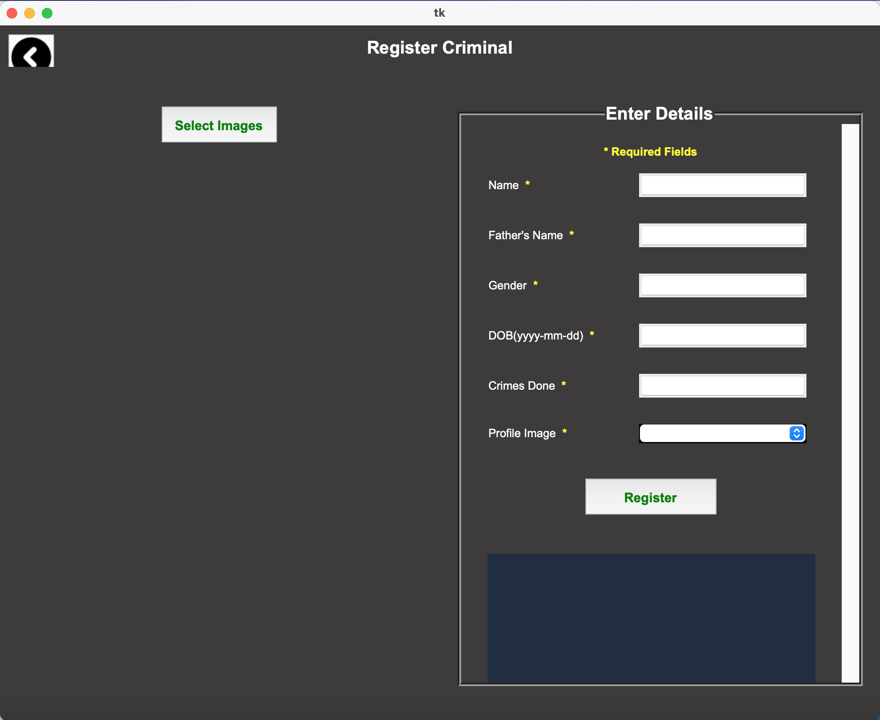
Criminal Registration: Criminal Registration page will ask the user to select atleast 5 images of the criminal that needs to be registered and also provides input form for providing various details of the criminal like his Name, DOB, Identification mark, Profile picture etc.

Slide 30
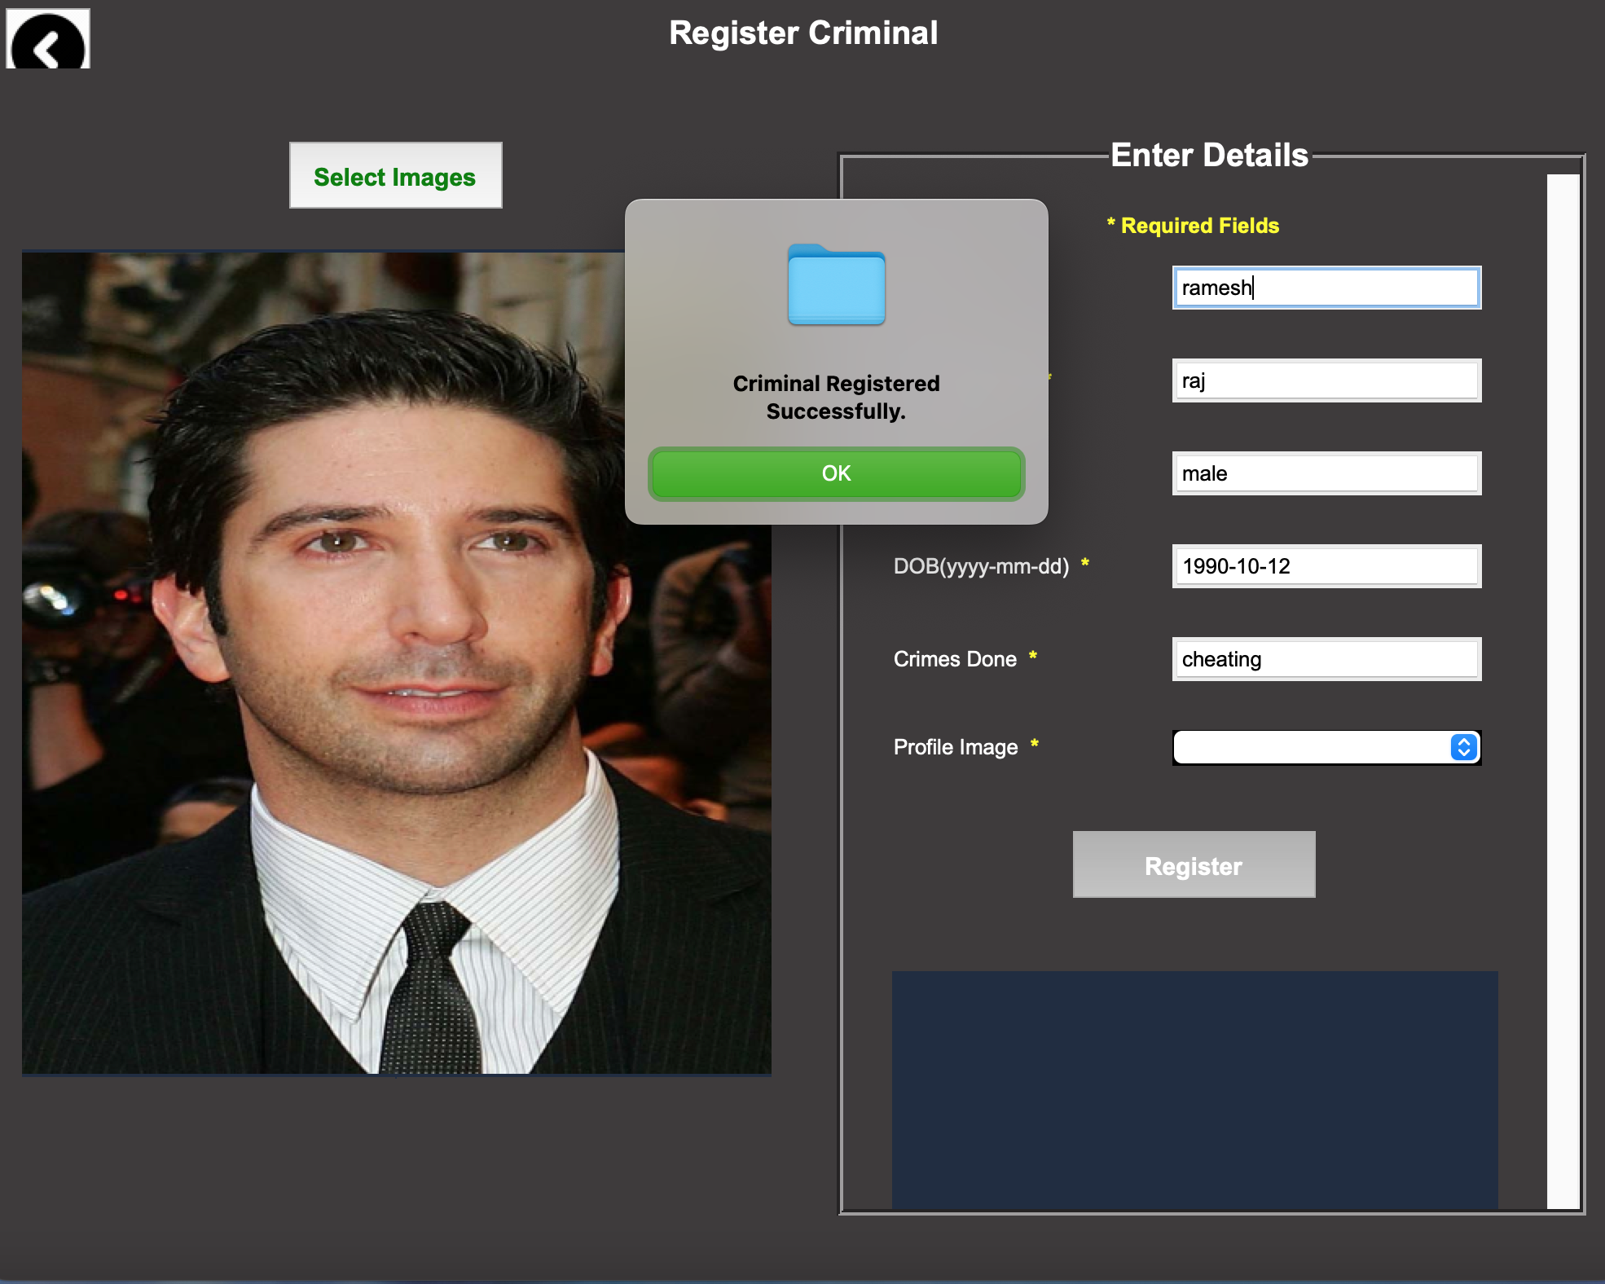

Slide 31
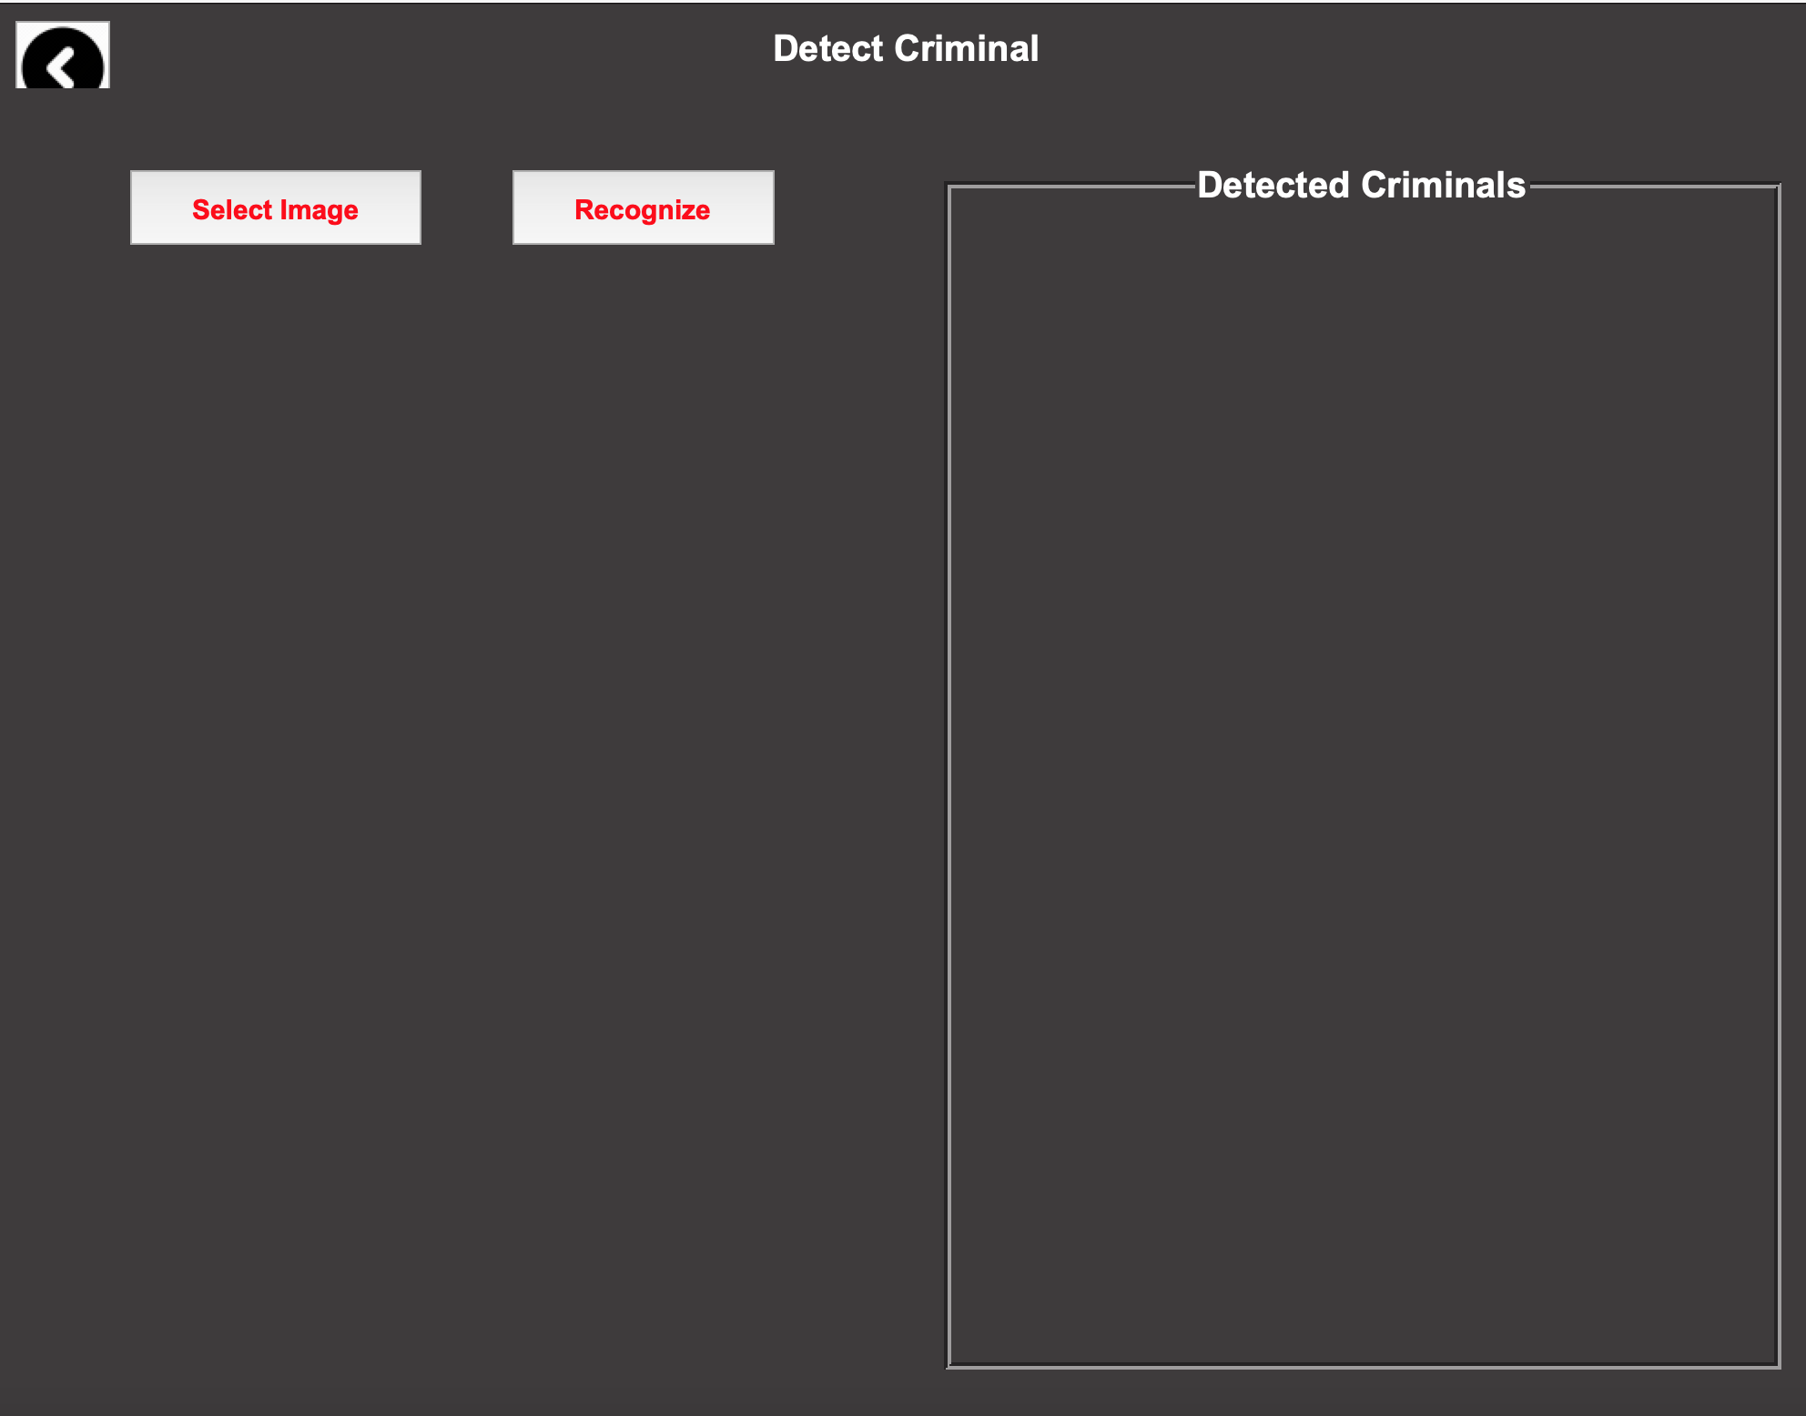
Detect Criminal Page: This page allows the user to browse an image from the system and helps in detecting criminals.

Slide 32
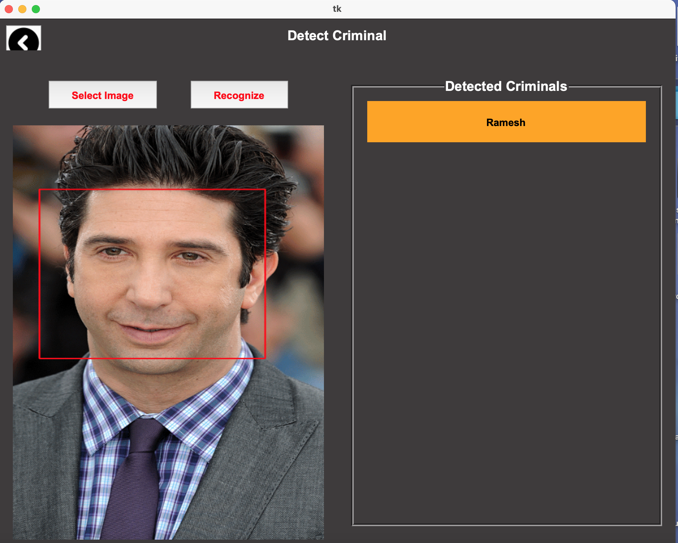

Slide 33
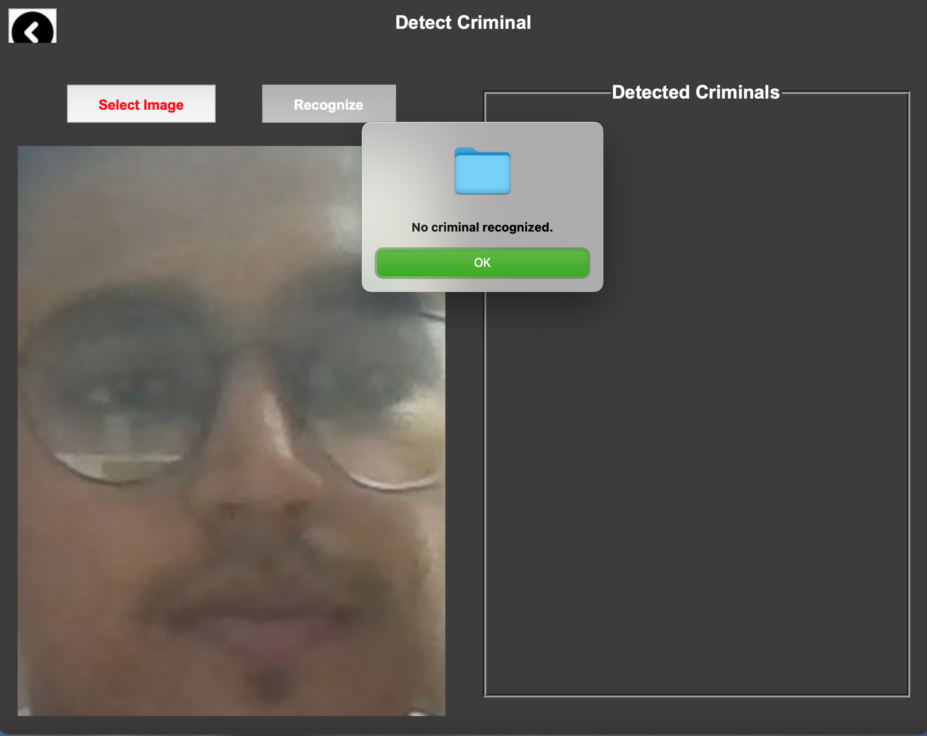
Detecting Unknown Criminal: Our system is able to identify a non-criminal face.

Slide 34
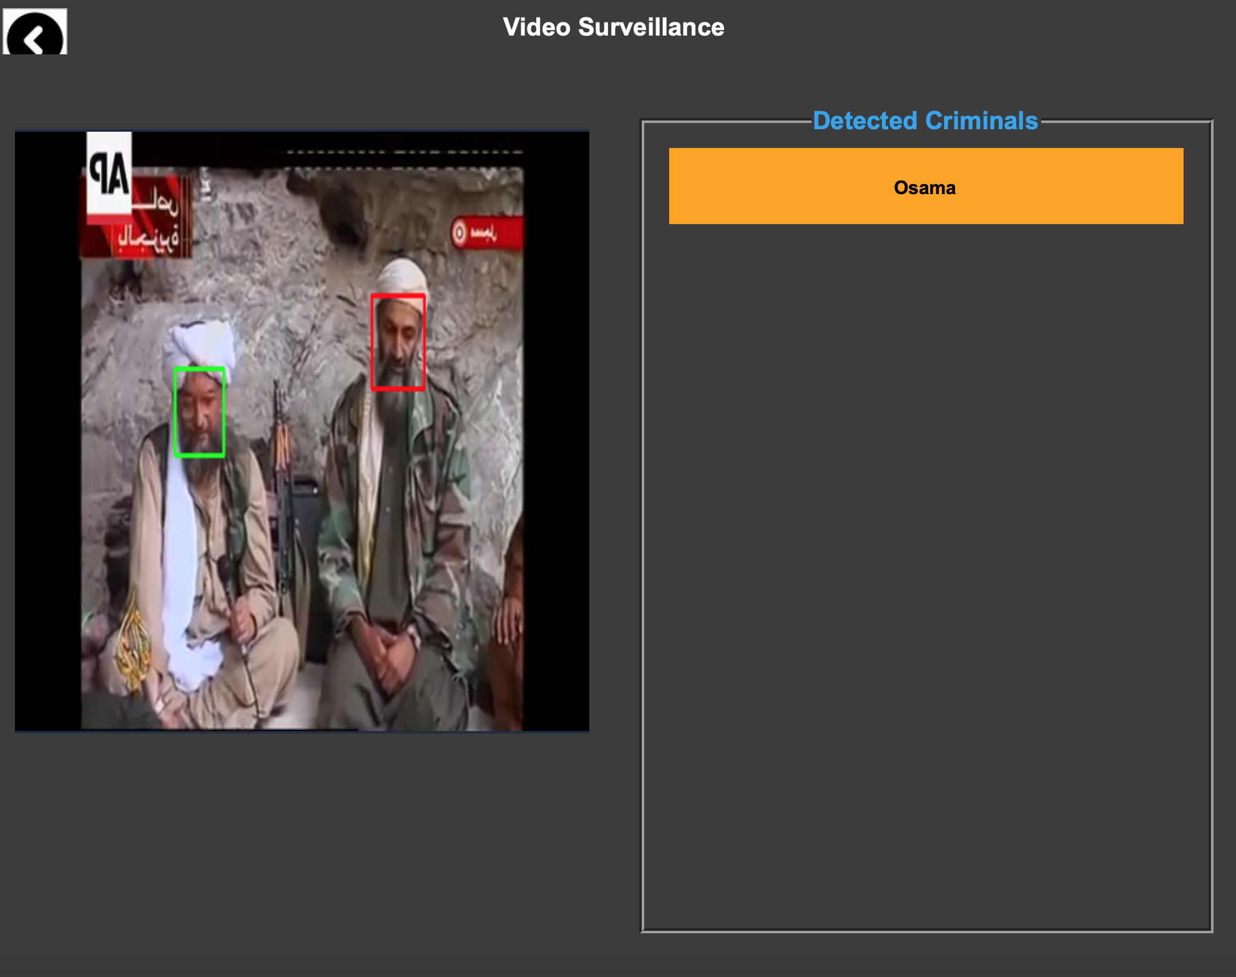
Video Surveillance: This page will use the pc webcam to capture the video frames in real time. After this it will use face detection module on each frame to detect and recognize criminals in the video in real time.

Slide 35
CONCLUSION AND FUTURE SCOPE
The application “criminal detecting system” not only provides a huge convenience to the Police in the identification of criminals but also saves time, energy ,man-power for them as processes are automated in the system.
For future work, we can add the Alarms to the criminal detection system. It will range only when matches are found so that if anyone is not there to keep watch in the CCTV room, they will come to know that someone is found from the database in that public place.

Slide 36
REFERENCES
[1]. Fu Jie Huang Zhihua Zhou “Pose Invariant Face Recognition”.
[2].Apoorva.P, Ramesh.B and Varshitha.M.R “Automated criminal identification by face recognition using open computer vision classifiers” Third International Conference on Computing Methodologies and Communication (ICCMC 2019)
[3]. Rabia Jafri* and Hamid R. Arabnia* A Survey of Face Recognition Techniques
[4].Piyush Kakkar, Mr. Vibhor Sharma (2018) “Criminal Identification System Using Face Detection and Recognition”. International Journal of Advanced Research in Computer and Communication Engineering.

Slide 37
THANK YOU

